Slide 1
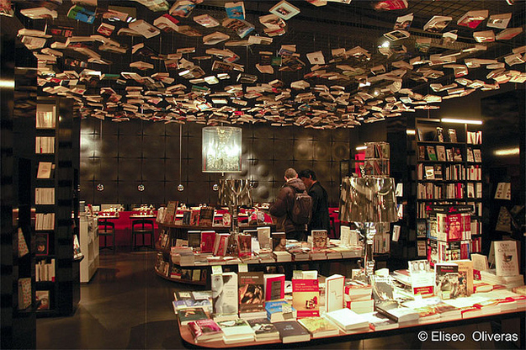
Putting the Shop back into Shopping
Selling Books in a Digital Age

Slide 2
Past Decade
Internet has embedded itself into our everyday experiences and made our life easier. By doing that, it made many actions and certainties outdated and obsolete. And there is no way back.
In retail alone : Clicks and Bricks / Functional and emotive shopping / Social Media / Smartphones / Gaming / Showrooming / Streaming / Downloads / ....

Slide 3
Retail : Amazon-effect
Amazon understands the three basic principles of retail :
Easy
Cheap prices
Great customer experience
For the past decade bookretail has been trying to simulate Amazon. Chasing after them with very little success

Slide 4
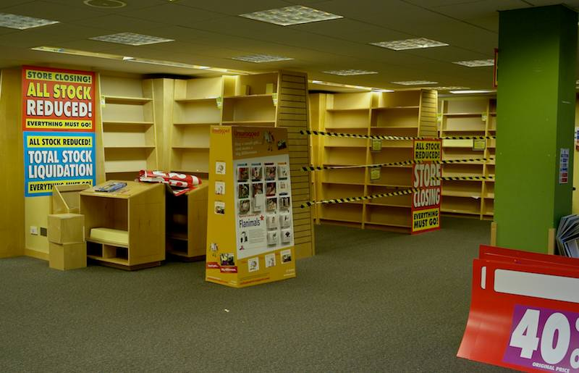
Are bricks bookstores doomed?

Slide 5
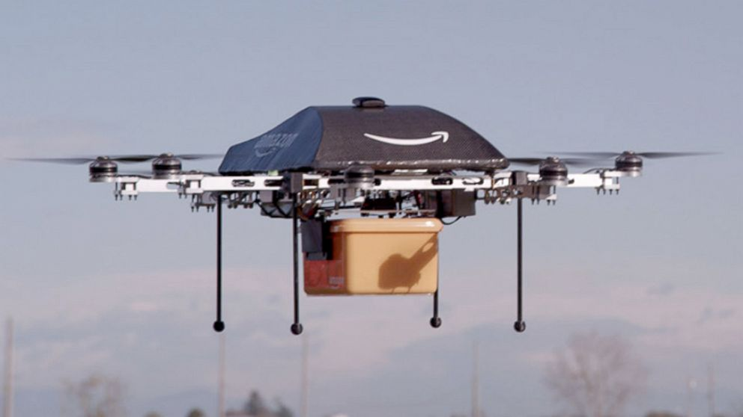
Is this the Future of Bookselling?

Slide 6
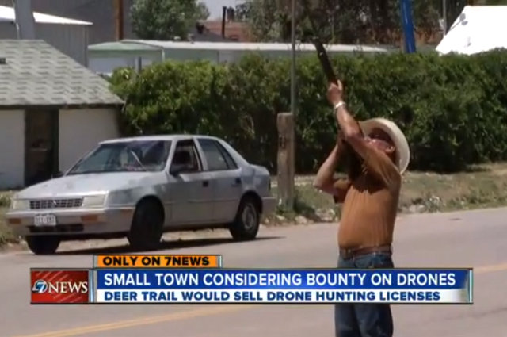
Is this the solution for other Bookstores?

Slide 7
The Bookstore has evolved
There is a new innovative generation looking at things differently.
Bookstores are building their business around their unique experiences and services.
They are adding coffeeshops, different producttypes, coworking spaces, have dj’s for bookstore parties, have a local presence, ...
They embrace the digital reality and build online answers to build their fanbase.
The next decade will be less about the next big technological discovery and more about it’s seamless integration into our life. No longer standing in amazement about what it can do, but enjoying it.

Slide 8
The conundrum ebooks
Because of the extremely low margins on ebooks, the unnatural connection between a digital product and a physical place and the difficult customer experience, ebooks still don’t offer a real business model for the bookstore.
But bookstores can use the digital formats in different ways. Ebooks are also information carriers and they can offer support in selling paper books
 | Nederlandse consument | Vlaamse consument illegale bron | Vlaamse consument legale en illegale bron
Boek | Gemid. € 17,71 | Gemid. € 13,71 | Gemid. € 15,63
E-boek | Gemid. € 7,81 | Gemid. € 4,75 | Gemid. € 8,41

Slide 9
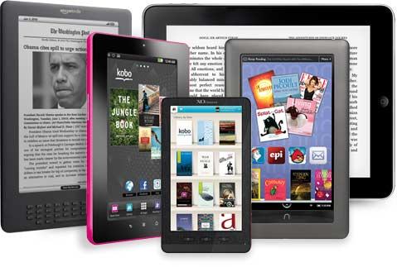
Trend 1 : Interoperability

Slide 10
Customers don’t care about the different systems. They just want to be able to read the ebook they bought on any device they choose to. Restrictions on the use of ebooks in order to protect them against copying, can have the exact opposite result. Customers have to search for ways to remove the DRM in order to read it on their devices and see how easy it is to do that.

Slide 11
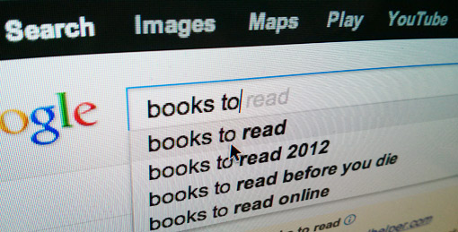
Trend 2 : Discoverability

Slide 12
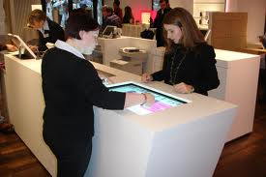
Helping customers discover the books the are looking for and the books they didn’t know they were looking for / Helping customers to find your bookstore and giving them reasons discover you / It’s about mapping out the customer journey of your store and looking at opportunities
Projects : Reading Room & semantic engine

Slide 13
Project : Digital Signage for Bookstores

Slide 14
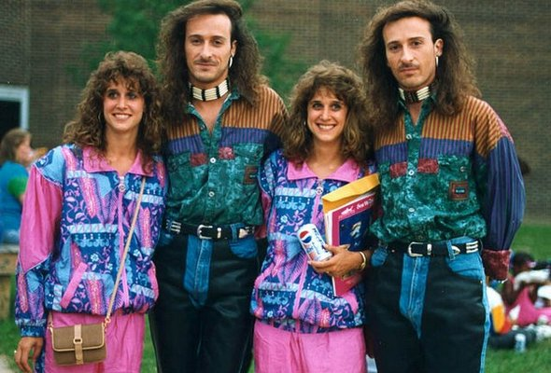
Trend 3 :Personalized / Unique

Slide 15
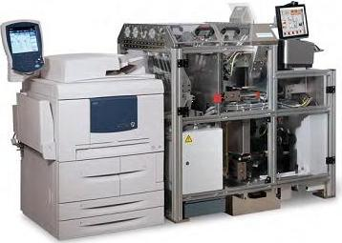
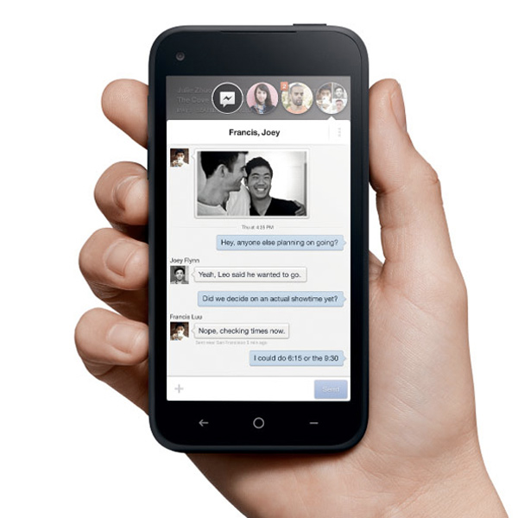
It’s about creating unique experiences and products to strengthen the bond between the bookshop and the customer / Being able to offer the customer a book in any format printed or digital / guiding customers through books recommended for them based upon their interests and customer history.
project : ‘especially for you’ recommendations through your smartphone

Slide 16
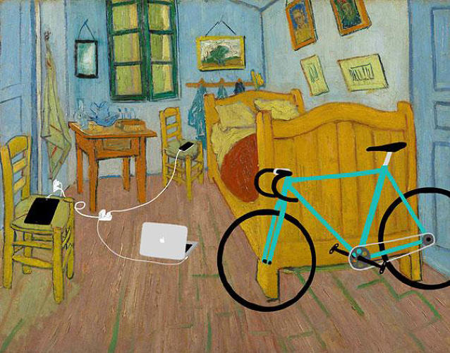
Trend 4 : Cocreation / Collaboration

Slide 17
Working together to create better customer experiences / Adding layers over the shopping experiene / Activating your customers by making them a part of the shop / Working together with content providers to create personal products / Local collaboration to create a better service
Projects : Connect local & social
Bookstores have a lot of data on their customers. Why not use this data to create personal experiences and products?
Local bookstores are collaborating with bike courriers to instantly deliver local orders to the customers homes.

Slide 18
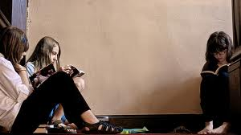
Trend 5 : Social connection

Slide 19
It’s not the reading as such that is a social process, but talking about books is. This one is about sharing experiences and being guided by sources you trust. / It’s connecting to your social network
project : iWish

Slide 20
Any questions?
Thank you!
Contact me!
email : Davy@boek.be
twitter : @Davy_Hanegreefs

